Slide 1
Design and Analysis of Algorithms NP-Completeness
Slides from: Haidong Xue

Slide 2
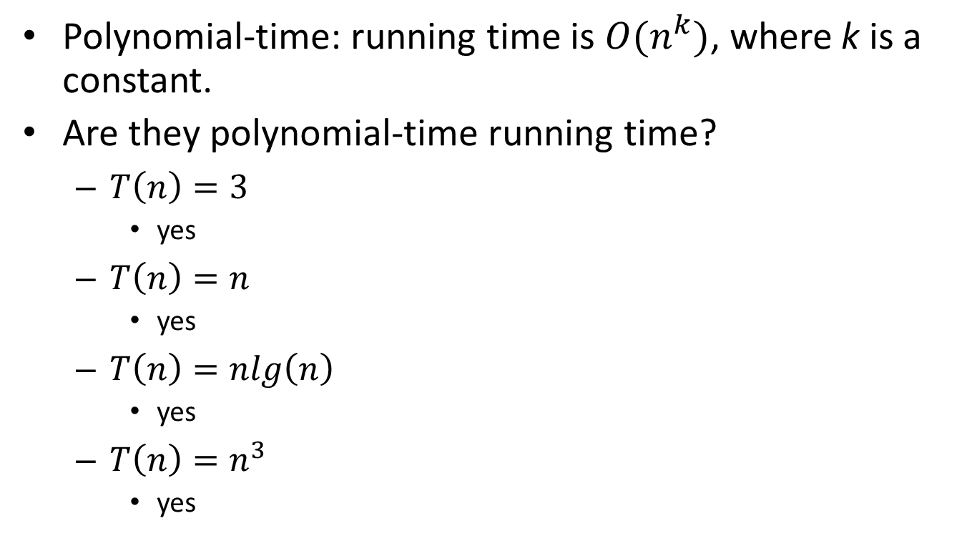
What is polynomial-time?
Polynomial-time: running time is $O(n^{k})$, where k is a constant.
Are they polynomial-time running time?
$T\left(n\right)=3$
yes
$T\left(n\right)=n$
yes
$T\left(n\right)=nlg\left(n\right)$
yes
$T\left(n\right)=n^{3}$
yes

Slide 3
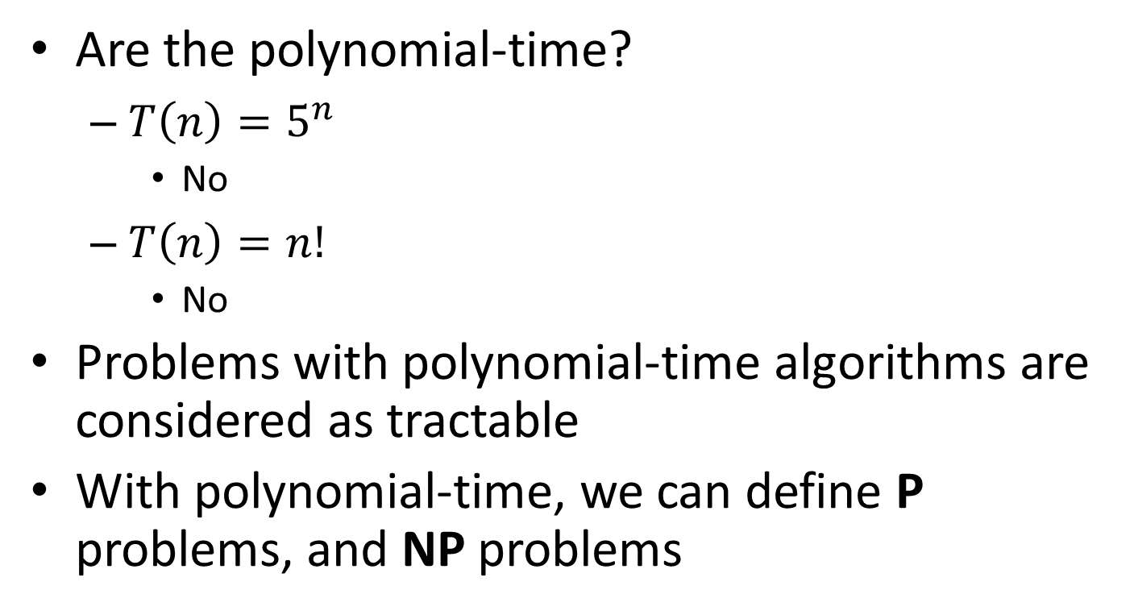
What is polynomial-time?
Are the polynomial-time?
$T\left(n\right)=5^{n}$
No
$T\left(n\right)=n!$
No
Problems with polynomial-time algorithms are considered as tractable
With polynomial-time, we can define P problems, and NP problems

Slide 4
What are P and NP?
P problems
(The original definition) Problems that can be solved by deterministic Turing machine in polynomial-time.
(A equivalent definition) Problems that are solvable in polynomial time
Examples
A set of decision problem with yes/no answer
Calculating the greatest common divisor
sorting n numbers in ascending or descending order
search the element in the list

Slide 5
What are P and NP?
NP problems
(The original definition) Problems that can be solved by non-deterministic Turing machine in polynomial-time.
(A equivalent definition) Problems that are verifiable in polynomial time.
Given a solution, there is a polynomial-time algorithm to tell if this solution is correct
Examples
(i) Integer Factorization
(ii) Graph Isomorphism

Slide 6
What are P and NP?
Polynomial-time verification can be used to easily tell if a problem is a NP problem
E.g.:
Sorting, n-integers
A candidate: an array
Verification: scan it once
Max-heapify, n-nodes:
A candidate: a complete binary search tree
Verification: scan all the nodes once
Find all the sub sets of a given set A, |A|=n
A candidate: a set of set
Verification: check each set

Slide 7
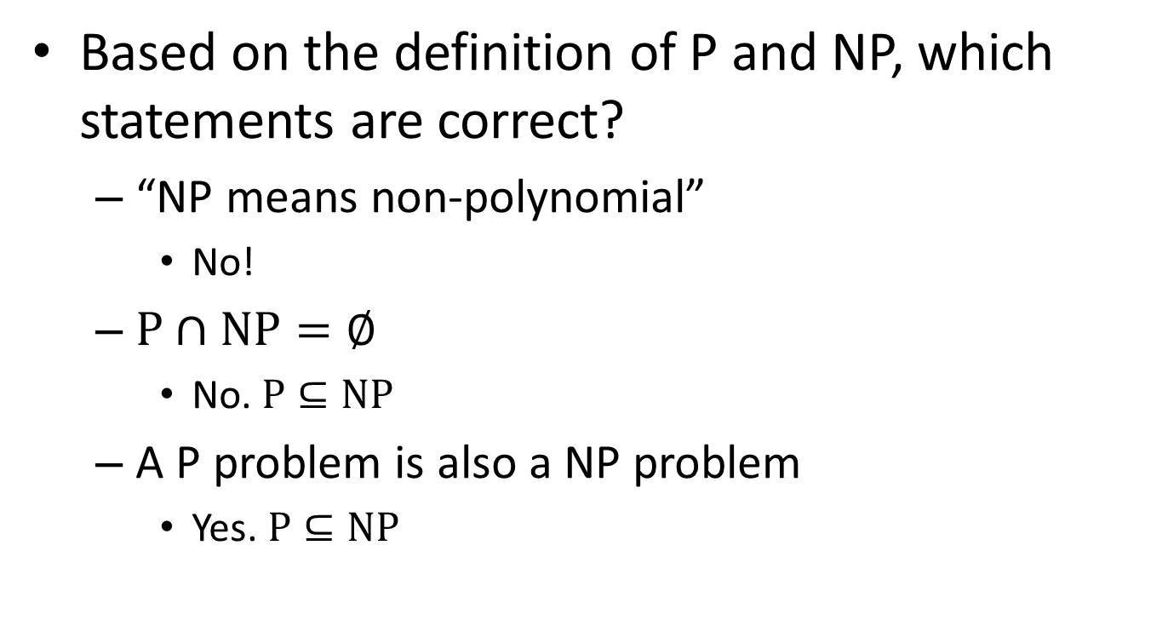
What are P and NP?
Based on the definition of P and NP, which statements are correct?
“NP means non-polynomial”
No!
$P∩NP=∅$
No. $P⊆NP$
A P problem is also a NP problem
Yes. $P⊆NP$

Slide 8
What are P and NP?
any problem solvable by a deterministic Turing machine in polynomial time is also solvable by a nondeterministic Turing machine in polynomial time. Thus, P ⊆ NP
P = NP means whether an NP problem can belong to class P problem. In other words whether every problem whose solution can be verified by a computer in polynomial time can also be solved by a
computer in polynomial time

Slide 9
What are P and NP?
In order to prove that P ≠ NP, we would need to prove that there exists a set of problems X such that:
X falls in NP. There exists an algorithm with which a nondeterministic Turing machine could solve problems in X in polynomial time
X does not fall in P. There exists no algorithm whatsoever with which a deterministic Turing machine could solve problems in X in polynomial time

Slide 10
What are NP-complete problems?
A NP-complete problem(NPC) is
a NP problem
harder than all equal to all NP problems
In other words, NPC problems are the hardest NP problems
So far, no polynomial time algorithms are found for any of NPC problems

Slide 11
What are NP-complete problems?
Most scientists believe:
However, it is not ruled out that:
NP
NP=NPC=P
NPC
P
NP-Hard problems: problems harder than or equal to NPC problems

Slide 12
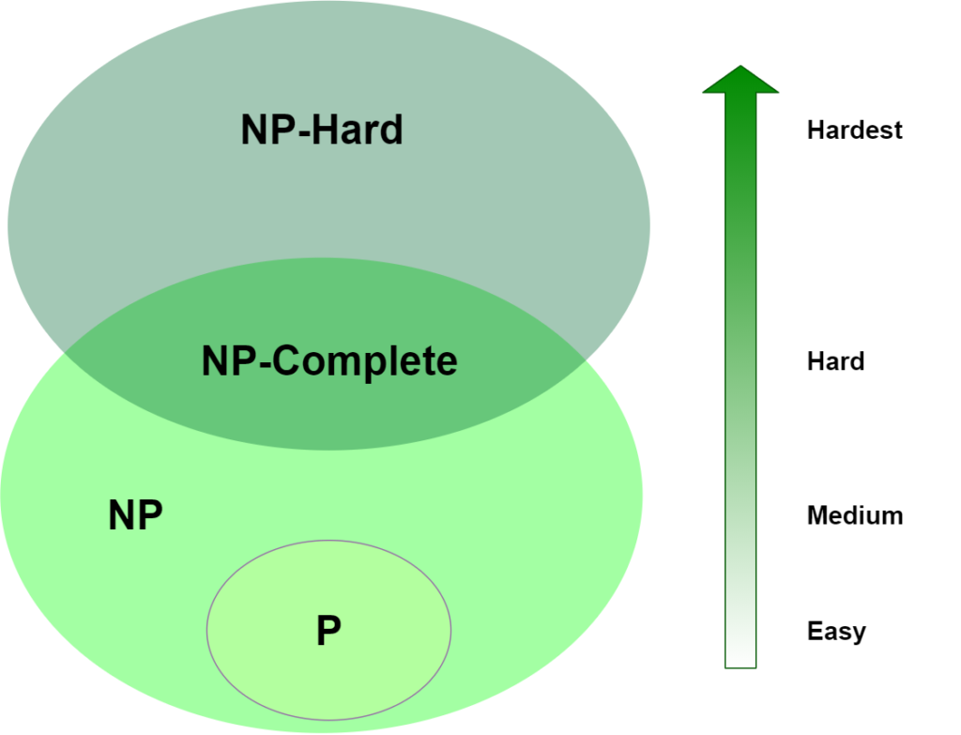
Notes:
NOW P=NP ? is the biggest question which is still unsolved. to solve this you have to prove either way given below
1.if P=NP then give solution for the algorithm in NP solved by deterministic algorithm (means possible in theory as well as in practice)in polynomial time
2.if not then prove that the algorithm in NP will take minimum exponential time to solve and it can not be solved in polynomial time by using deterministic algorithm.
The problem in NP-Hard cannot be solved in polynomial time, until P = NP. If a problem is proved to be NPC, there is no need to waste time on trying to find an efficient algorithm for it. Instead, we can focus on design approximation algorithm.

Slide 13
NP-hard | NP-Complete
NP-Hard problems(say X) can be solved if and only if there is a NP-Complete problem(say Y) that can be reducible into X in polynomial time | NP-Complete problems can be solved by a non-deterministic Algorithm/Turing Machine in polynomial time.
To solve this problem, it do not have to be in NP . | To solve this problem, it must be both NP and NP-hard problems.

Slide 14
Why we study NPC?
One of the most important reasons is:
If you see a problem is NPC, you can stop from spending time and energy to develop a fast polynomial-time algorithm to solve it.
Just tell your boss it is a NPC problem
How to prove a problem is a NPC problem?

Slide 15
How to prove a problem is a NPC problem?
A common method is to prove that it is not easier than a known NPC problem.
To prove problem A is a NPC problem
Choose a NPC problem B
Develop a polynomial-time algorithm translate A to B
A reduction algorithm
If A can be solved in polynomial time, then B can be solved in polynomial time. It is contradicted with B is a NPC problem.
So, A cannot be solved in polynomial time, it is also a NPC problem.

Slide 16
What if a NPC problem needs to be solved?
Buy a more expensive machine and wait
(could be 1000 years)
Turn to approximation algorithms
Algorithms that produce near optimal solutions

